Slide 1
Ch.9 Graph(III)
Shortest Path Algorithms

Slide 2
Weighted path length :
Unweighted path length: merely the number of
edges on the path.
v₁
2
v₂
v₁
v₂
4
1
3
10
v₃
2
v₄
2
v₅
v₃
v₄
v₅
8
4
6
5
v₆
1
v₇
v₆
v₇

Slide 3
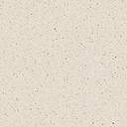
1. Single-Source Shortest-Path Problem
Given as input a weighted graph, G = ( V, E ), and a distinguished vertex, s, find the shortest weighted path from s to every other vertex in G.
Negative-cost cycle
v₁
2
v₂
v₁
2
v₂
4
1
3
10
4
1
–10
2
2
2
3
2
Note: If there is no negative-cost cycle, the length of the shortest path from s to s is defined to be zero.
v₃
v₄
v₅
v₃
v₄
v₅
8
4
6
8
4
6
5
5
v₆
1
v₇
v₆
1
v₇

Slide 4

➢ Unweighted Shortest Paths
❖ Sketch of the idea
1
v₁
v₂
2
0:  v₃
Breadth-first search
2
1: 
v₁ and v₆
0
v₃
v₄
v₅
3
2: 
v₂ and v₄
1
v₆
v₇
3
3: 
v₅
and v₇
❖ Implementation
Table[ i ].Dist ::= distance from s to v_{i} /* initialized to be ∞ except for s */
Table[ i ].Known ::= 1 if v_{i} is checked; or 0 if not /* initialized to be 0 */
Table[ i ].Path ::= for tracking the path /* initialized to be 0 */

Slide 5
v₁
v₂
v₃
v₄
v₅
void Unweighted( Table T )
{ int CurrDist;
Vertex V, W;
for ( CurrDist = 0; CurrDist < NumVertex; CurrDist ++ ) {
for ( each vertex V )
if ( !T[ V ].Known && T[ V ].Dist == CurrDist ) {
T[ V ].Known = true;
for ( each W adjacent to V )
if ( T[ W ].Dist == Infinity ) {
T[ W ].Dist = CurrDist + 1;
T[ W ].Path = V;
} /* end-if Dist == Infinity */
} /* end-if !Known && Dist == CurrDist */
} /* end-for CurrDist */
}
v₆
v₇
If V is unknown yet has Dist < Infinity, then Dist is either CurrDist or CurrDist+1.
 T = O( |V|² )

Slide 6
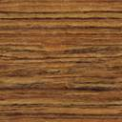
❖ Improvement
1
2
void Unweighted( Table T )
{ /* T is initialized with the source vertex S given */
Queue Q;
Vertex V, W;
Q = CreateQueue (NumVertex ); MakeEmpty( Q );
Enqueue( S, Q ); /* Enqueue the source vertex */
while ( !IsEmpty( Q ) ) {
V = Dequeue( Q );
T[ V ].Known = true; /* not really necessary */
for ( each W adjacent to V )
if ( T[ W ].Dist == Infinity ) {
T[ W ].Dist = T[ V ].Dist + 1;
T[ W ].Path = V;
Enqueue( W, Q );
} /* end-if Dist == Infinity */
} /* end-while */
DisposeQueue( Q ); /* free memory */
}
v₁
v₂
0
2
3
v₃
v₄
v₅
v₆
v₇
1
3
Dist Path
v₁
∞
1
0
v₃
v₇
v₂
∞
2
0
v₁
v₅
v₃
0
0
v₄
v₄
∞
2
0
v₁
v₅
∞
v₂
3
0
v₂
v₆
∞
1
0
v₃
v₆
v₇
∞
3
0
v₄
v₃
v₁
T = O( |V| + |E| )

Slide 7
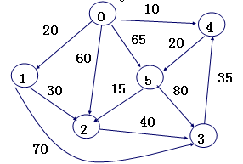
➢ Dijkstra’s Algorithm (for weighted shortest paths)
We assume that there is a path from the source vertex s to every other vertex in the graph.
Observation: if v_{k} is the second last vertex on the shortest path from s to v_{j},…
Strategy: greedy algorithm
Let S be the set of vertices whose minimum distance from the source vertex has been found , i.e. S = { s and vertices whose shortest paths have been found }.
Initially S ={s}.
S
v_{k}
s
v_{j}

Slide 8
Suppose the source vertex is v₀.
The algorithm is iterative, adding one vertex to S on each pass.
For each vertex v_{i ,} we keep all the information as before: known, p_{v} ,and d_{v}. d_{v} is the minimum distance from the source vertex to v_{i} via vertices that are already in S.

Slide 9
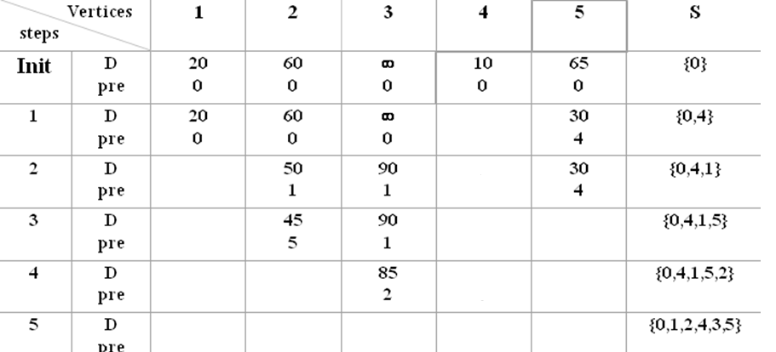
Example of Dijkstra's Algorithm

Slide 10
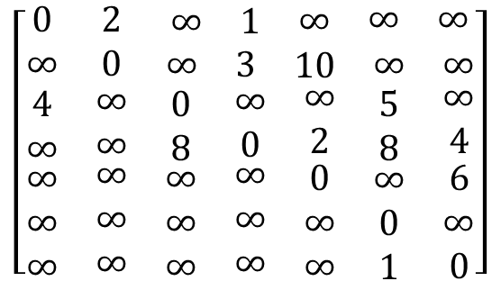
Example: find the shorstest path from v3 to all other vertices
2
v₁
v₂
v₃
v₁
v₂
v₄
v₅
v₆
v₇
3
v₁
4
1
10
v₂
2
2
v₃
v₃
v₄
v₅
8
4
v₄
5
6
v₅
1
v₆
v₆
v₇
v₇

Slide 11
STEPS:
let S={v₀}, compute Table[i].Dist for each vertex v_{i} as following:
0 if i=0
c_{0i} if i≠0, and <v₀,v_{i}> is an edge, c_{0i} is the weight
∞ if i≠1，and < v₀,v_{i}> is not an edge
Table[i].Dist=
choose the vertex v_{k} such that:
Table[k].Dist= min { Table[j].Dist |v_{j}∉S }
then the v_{k} is terminal of the next shortest path and Dist is its cost.
Place v_{k} in S. That is
S = S ∪{v_{k}}
For each v_{j}∉S, modify the Table[j].Dist:
Table[j].Dist = min {Table[j].Dist, Table[k].Dist +weight(<v_{k},v_{j}>)
Repeat 2---4 until all vertices have been added in S.

Slide 12
void Dijkstra( Table T )
{ /* T is initialized by Figure 9.30 on p.303 */
Vertex V, W;
for ( ; ; ) {
V = smallest unknown distance vertex;
if ( V == NotAVertex )
break;
T[ V ].Known = true;
for ( each W adjacent to V )
if ( !T[ W ].Known )
if ( T[ V ].Dist + Cvw < T[ W ].Dist ) {
Decrease( T[ W ].Dist to
T[ V ].Dist + Cvw );
T[ W ].Path = V;
} /* end-if update W */
} /* end-for( ; ; ) */
}
/* O( |V| ) */
/* not work for edge with negative cost */
Please read Figure 9.31 on p.304 for printing the path.

Slide 13
❖ Implementation 1
V = smallest unknown distance vertex;
/* simply scan the table – O( |V| ) */
T = O( |V|² + |E| )
Good if the graph is dense
❖ Implementation 2
V = smallest unknown distance vertex;
/* keep distances in a priority queue and call DeleteMin – O( log|V| ) */
Decrease( T[ W ].Dist to T[ V ].Dist + Cvw );
Good if the graph is sparse
/* Method 1: DecreaseKey – O( log|V| ) */
T = O( |V| log|V| + |E| log|V| ) = O( |E| log|V| )
/* Method 2: insert W with updated Dist into the priority queue */
/* Must keep doing DeleteMin until an unknown vertex emerges */
T = O( |E| log|V| ) but requires |E| DeleteMin with |E| space

Slide 14
Minimum Spanning Trees
A spanning tree (生成树)of an undirected graph G is a tree containing all the vertices V(G).
〖Example〗 A complete graph and three of its spanning trees
Note:
It is spanning because it covers every vertex.
A spanning tree exists iff G is connected.
The spanning tree is a tree since it is acyclic -- the number of edges is |V| – 1.
Adding a non-tree edge to a spanning tree, we obtain a cycle.

Slide 15
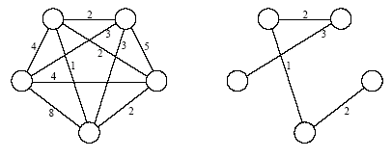
Minimum Spanning Trees
In a weighted graph, the weight of a subgraph is the sum of the weights of all the edges in the subgraph.
A minimum spanning tree (MST) for a weighted graph is a spanning tree with minimum weight.
An undirected graph and its minimum spanning tree.

Slide 16
Finding MST of a Graph
Solution to find minimum spanning trees must satisfy the following constraints :
we must use only edges within the graph
we must use exactly |V| – 1 edges
we may not use edges that would produce a cycle
Two efficient well known methods
Prim’s algorithm
Kruskal’s algorithm

Slide 17
Prim’s Algorithm
Greedy stratigy, very similar to Dijkstra’s algorithm.
v₁
2
v₂
4
1
3
10
v₃
2
v₄
7
v₅
8
4
5
6
v₆
1
v₇

Slide 18
v₁
2
v₂
4
1
3
10
v₃
2
v₄
7
v₅
8
4
5
6
v₆
1
v₇
void Dijkstra( Table T )
{ /* T is initialized by Figure 9.30 on p.303 */
Vertex V, W;
for ( ; ; ) {
V = smallest unknown distance vertex;
if ( V == NotAVertex )
break;
T[ V ].Known = true;
for ( each W adjacent to V )
if ( !T[ W ].Known )
if ( T[ V ].Dist + Cvw < T[ W ].Dist ) {
T[ W ].Dist=T[ V ].Dist + Cvw );
T[ W ].Path = V;
} /* end-if update W */
} /* end-for( ; ; ) */
}
void Prim( Table T )
{ /* T is initialized by Figure 9.30 on p.303 */
Vertex V, W;
for ( ; ; ) {
V = smallest unknown distance vertex;
if ( V == NotAVertex )
break;
T[ V ].Known = true;
for ( each W adjacent to V )
if ( !T[ W ].Known )
if ( Cvw < T[ W ].Dist ) {
T[ W ].Dist=Cvw );
T[ W ].Path = V;
} /* end-if update W */
} /* end-for( ; ; ) */
}

Slide 19
Examples for Kruskal’s Algorithm
10
0 5
2 3
1 6
1 2
3 6
3 4
4 6
4 5
0 1
12
14
0
0
28
16
1
1
10
14
16
18
5
6
2
5
6
2
24
22
25
18
12
4
4
24
22
3
3
25
cost = 10 +25+22+12+16+14
28

Slide 20
Kruskal’s Idea
Build a minimum cost spanning tree T by adding edges to T one at a time
Select the edges for inclusion in T in nondecreasing order of the cost
An edge is added to T if it does not form a cycle
Since G is connected and has n > 0 vertices, exactly n-1 edges will be selected

Slide 21
Kruskal’s algorithm
Edge by edge
Algorithm:
T={};
While ((T contains less than n-1 edges) &&(E not empty)){
choose an edge (v,w) from E of lowest cost;
delete (v,w) from E;
if((v,w) does not create a cycle in T)
add(v,w) to T;
else
discard(v,w);
}
If(T contains fewer than n – 1 edges)
printf(“No spanning tree\n”);

